Slide 1
RCHC’s Cardiovascular Health Initiative
Hypertension Management
Diabetes Management
PHASE
Cardiovascular disease, including heart attacks and strokes, is the leading cause of death in our community

Slide 2
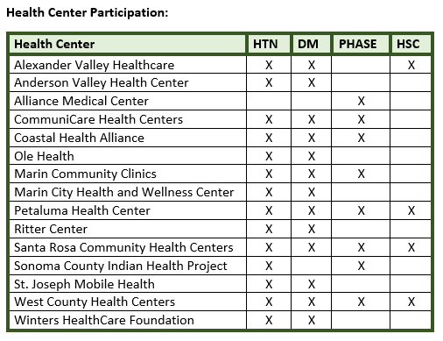
Preventing Heart Attacks and Strokes Everyday (PHASE) ~8,000 PHASE patients in 8 health centers in 22 clinic sites. PHASE combines a fixed-dose medication regimen with lifestyle changes.
Hypertension Program
Adults with HTN
PHASE
Adults at increased risk of MI, CHF, CVA
(DM, CAD, PAD, AAA, CVA/TIA)
Notes:
8,074 PHASE patients at 22 clinic sites

Slide 3
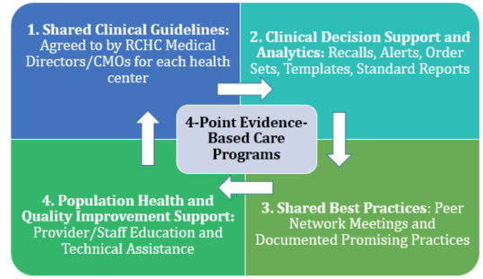
RCHC’s 4-Point Evidence Based Care (EBC) Program
Link to RCHC EBC Program Page

Slide 4
#1 Shared Clinical Guidelines
Hypertension
Diabetes
PHASE

Slide 5
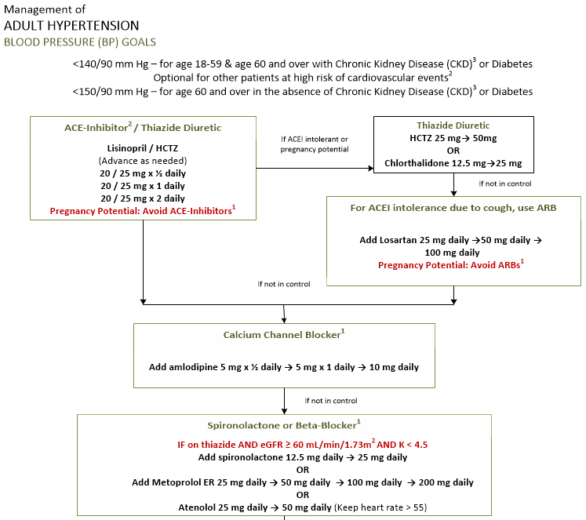

Slide 6
Medication Titration Algorithm for Type 2 Diabetes (May 2017)
Includes 2-page medication table

Slide 7
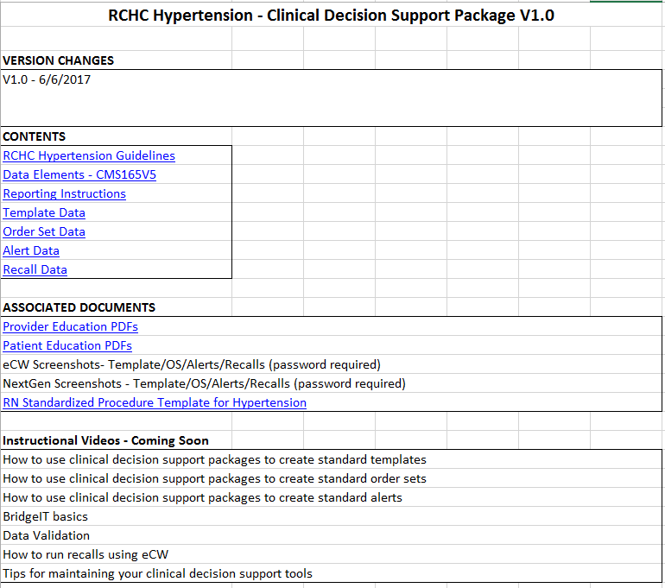
#2 HTN Clinical Decision Support Package
Link to RCHC Website

Slide 8
#3 RCHC Promising Practice Sharing
Link to RCHC Documented Promising Practices

Slide 9
#4 Population Health & Quality Improvement Support
Motivational Interviewing/Motivating Change
Health Coaching
Case Conference Webinars

Slide 10
Preventing Heart Attacks and Strokes Everyday RCHC PHASE Program
Cardiovascular disease, including heart attacks and strokes, is the leading cause of death in our community

Slide 12
WHAT IS ?
A population health management program to care for people with/at risk of cardiovascular disease using KP’s evidence based clinical protocol that, when followed, reduces CVD.

Slide 13
WHY ?
Cardiovascular disease (CVD) is the leading cause of death and disability in the US and in Yolo, Napa, Marin and Sonoma
A reduction in CVD of up to 80% has been projected for individuals at high risk for CVD who take cardioprotective medications
Prospective modeling predicts use of three cardioprotective medications (angiotensin-converting enzyme [ACE] inhibitors, aspirin, and statins) in high-risk individuals expected to reduce the number of myocardial infarctions (MIs) and strokes by 71% after five years of therapy
Few years after ALL (Aspirin, Lisinopril, Lipid-Lowering Med) implemented, rate of CVD events among Kaiser’s adult patients with diabetes reduced by estimated 60%

Slide 14
Recent Updates to Guideline September 2017
Removed CAD pathway on BP management; now the PHASE guideline for BP Goals matches the RCHC HTN Management Guideline
Statins: Replaced Simvastatin with Atorvastatin and clarified guidance for under 40 year olds
DM: Added alternative agents (Thiazoladinedione, Meglitinides, A-glucosidase Inhibitors, DPP-4 Inhibitor, SGLT-2 Inibitor, GLP-1 Receptor Antagonist)

Slide 15
PHASE Protocol (“PHASE on a Page”)

Slide 16
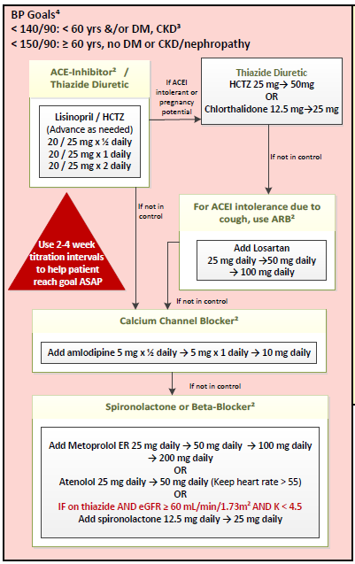

Slide 17
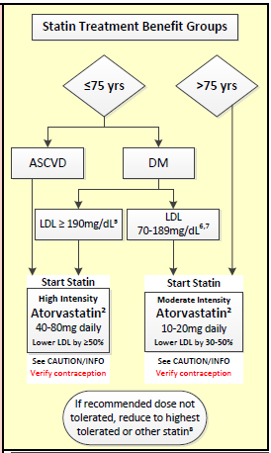

Slide 18
PHASE Guideline Footnotes
¹ ASA: 40-75y ASCVD, DM or 10y ASCVD risk >10%. Caution if on blood thinner (NSAID), hx GI bleed, or pregnancy potential.
² Reproductive potential alert -> verify effective contraception: ACE-I & ARBs (contraindicated in pregnancy), Calcium Channel Blockers & Spironolactone (Risk Category C); Beta-Blockers (Risk Category D); Statins (Risk Category X).
³ BP goal applies if eGFR>30 & if LVEF>40%. For people >70y with CKD should be individualized taking into consideration fragility, comorbidities & albuminuria.
⁴ CKD: microalbuminuria or [(age/2) + eGFR] <85.
⁵ Evaluate for 2ndary causes of hyperlipidemia.
⁶ Consider high-intensity statin If ASCVD risk>7.5% (www.cvriskcalculator.com)
⁷ Treating individuals <40y & >75y in with statins is optional; clinicians should evaluate potential ASCVD benefits, risks and patient preferences.
⁸ LDL monitoring is an option to assist with adherence assessment; consider lower statin dose if LDL<40 x 2.

Slide 19
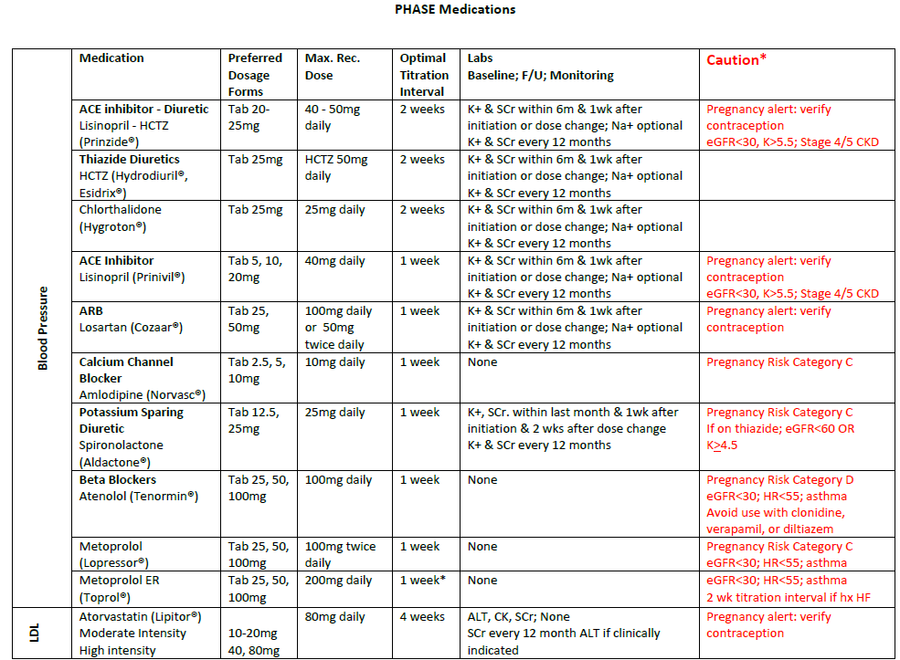

Slide 21
DM Guideline Footnotes
¹ Excluding Pregnancy – for pregnant women and women intending pregnancy, use CDAPP guidelines.
² Individualize A1c goal based on risk of hypoglycemia, duration of DM, life expectancy, co-morbidities, vascular complications, patient resources and support system.
³ Self Monitoring Blood Glucose targets: postprandial < 180mg/dL; bedtime 100-150 mg/dL.
⁴ Carries increased risk of Hypoglycemia. Severe hypoglycemia = resulting or likely to result in seizures, LOC, or needing help from others. Mild hypoglycemia = recognized signs and symptoms or neuro-glycopenia (e.g. hunger or sweating) that the patient can effectively self-treat.
⁵ Choice dependent on patient and disease-specific factors. Each new class of non-insulin agents lowers A1c ~ 1%. If A1c target is still not achieved after 3 months of dual therapy, proceed to three-drug combination.

Slide 22
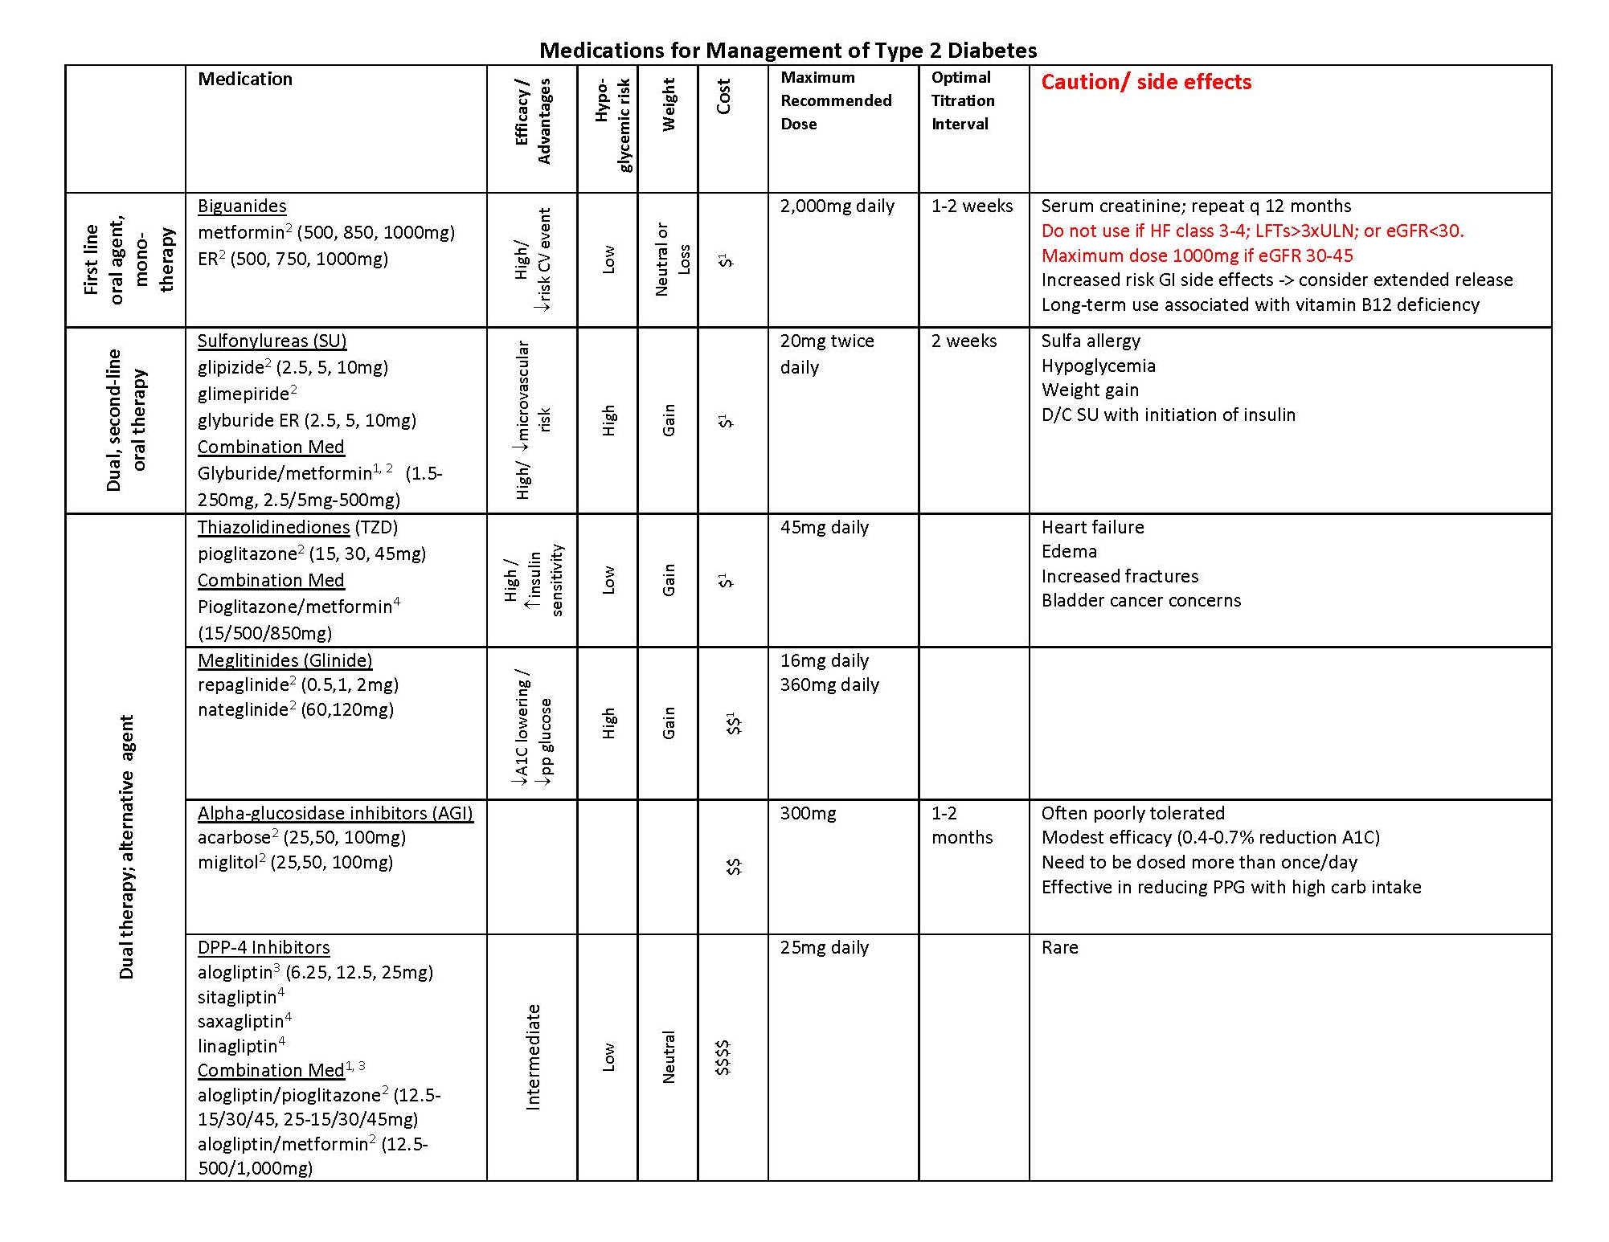

Slide 23
